Slide 1
Oauth and Spring Security
Srinivas Bhaskara

Slide 2
Agenda
Fundamentals of security. Oauth Why? What? Where?
OAuth and OIDC fundamentals
Spring Security fundamentals
Implementation of any security mechanism using Spring security
System design for OAuth implementation
Implementation of OAuth client
Implement out own authorization/Resource server.

Slide 3
Authentication Mechanisms
All over SSL/TLS protocol
Basic Credentials(Username and Password)
Certificate Based Authentication
Token Based Authentication
Oauth(Delegation Based Authorization) JWT Token Reference token
OIDC (Token Based Authentication) JWT Token Value token

Slide 4
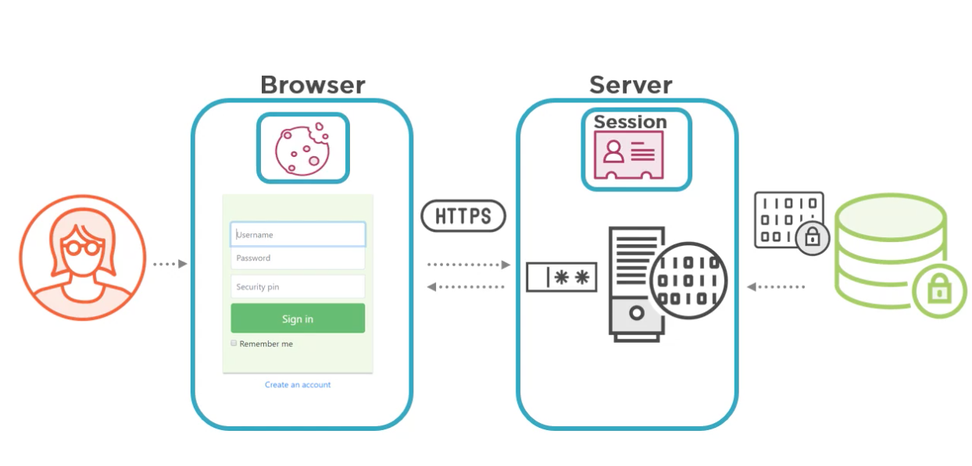
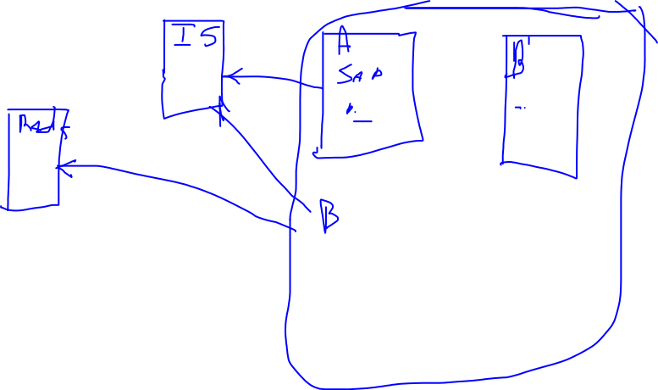

Slide 5
HomeWork
How do we maintain session across different clients with same user?
Session replication
How fast is the session replicated? Implementing SessionListener? Reads will be very fast but Writes are problem.
Performance problem if the replication number is high.
How do you replicate ? 2 Phase commit?
Pessimistic and optimistic approaches
To avoid repeatable reads problem(dirty read, repeatable read)
Sticky session
Scaling
Performance
No of sessions have to be limited to only one.
Redis
Single source of truth
Redis or any other database have to maintain high availability.
There might a delay for both read and write. I/O call there will be a network lag.
Traffic handling
Haselcast
How is the same user logged in across 2 different client?
Try implement this in Spring security. Filter to be written.
Any other challenges after identifying? Or while identifying?
Can I maintain same session across different apps like SAP IT Direct and SAP HR?

Slide 6
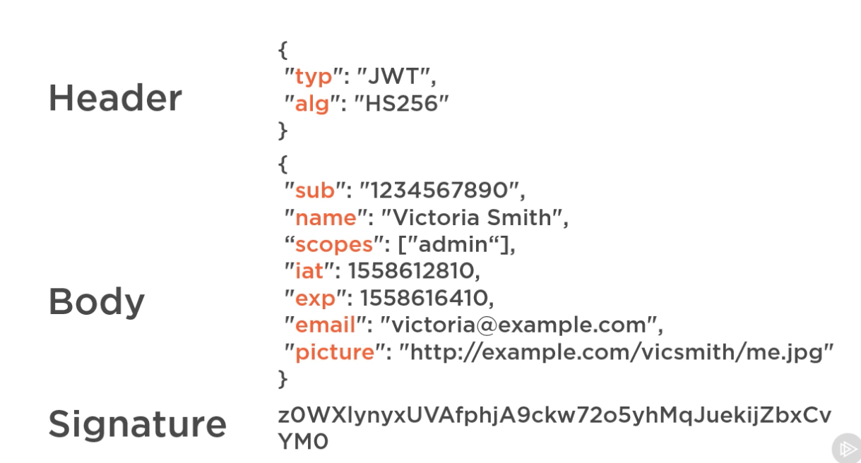
OIDC Token

Slide 7
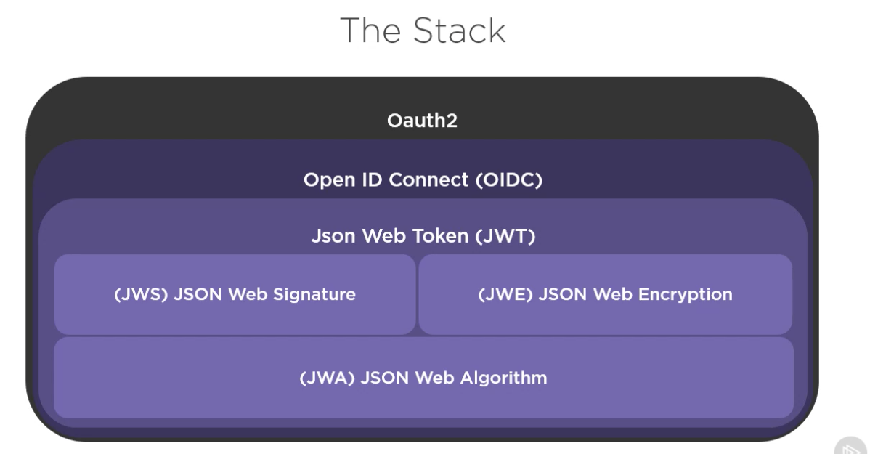
OAUTH OIDC Stack

Slide 8
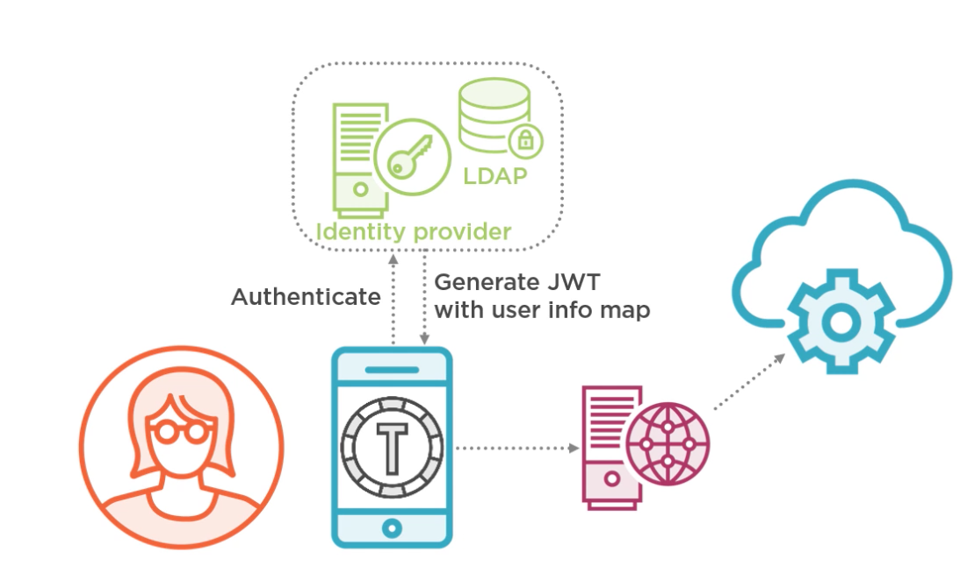

Slide 9
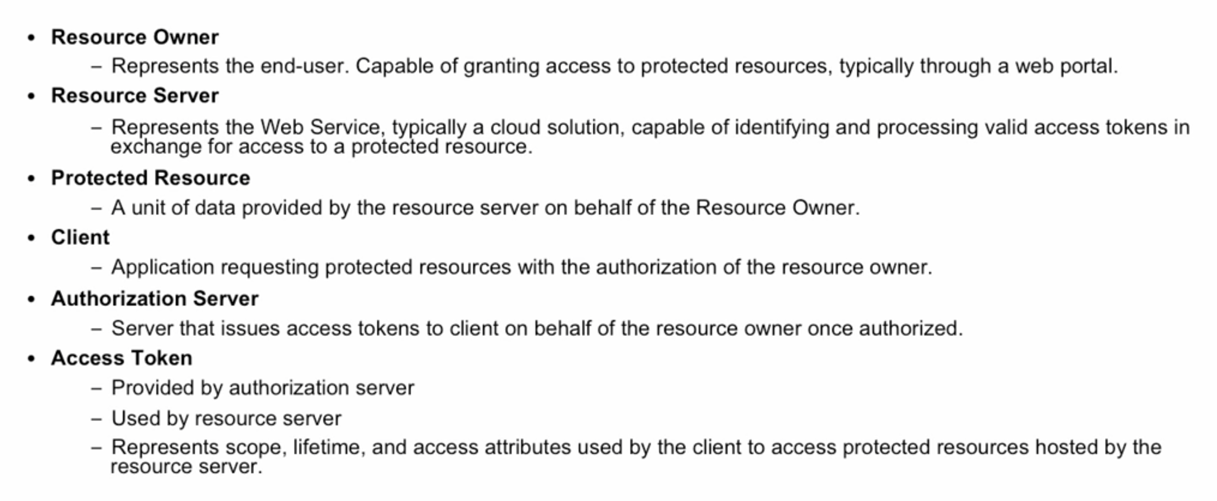
OAuth vocabulary

Slide 10
Jargons
Principal – Logged in user
Granted Authority (Permissions) – Fine grained – Functionalities
Roles – Coarse grained
Spring-boot-starter-security
Spring.security.user.name=foo
Spring.security.user.password=bar

Slide 11
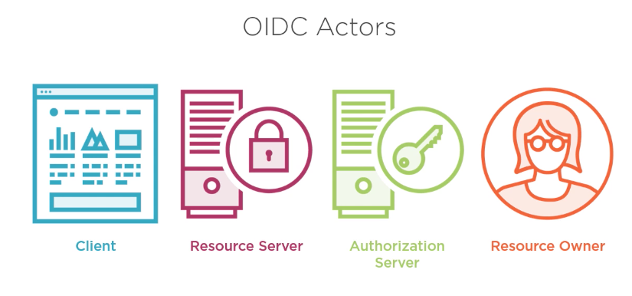
Actors

Slide 12
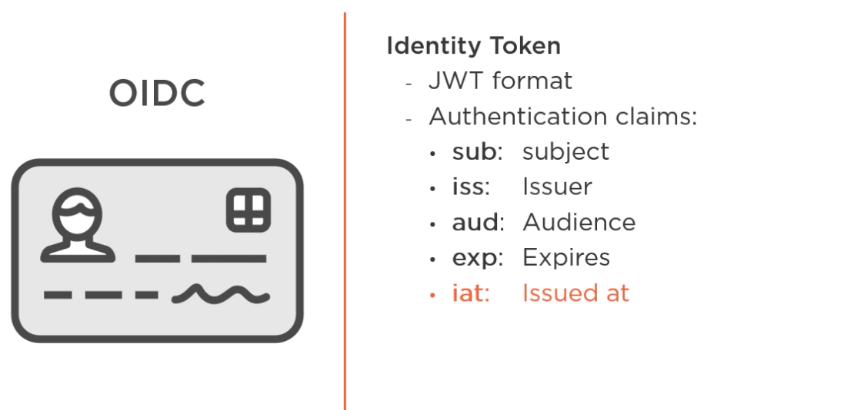
Identity Token

Slide 13
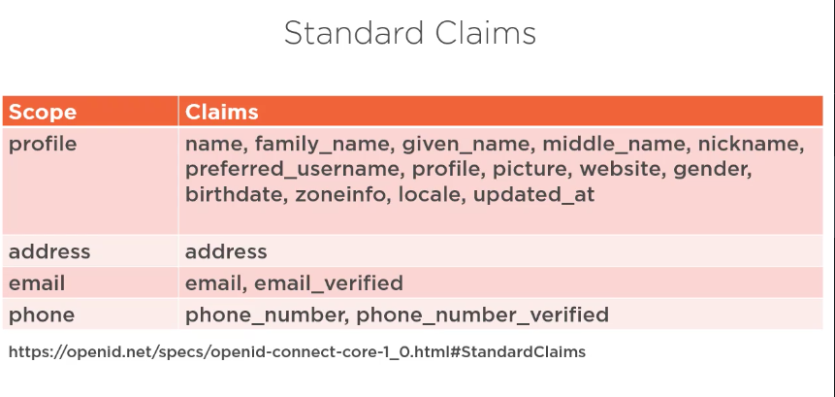
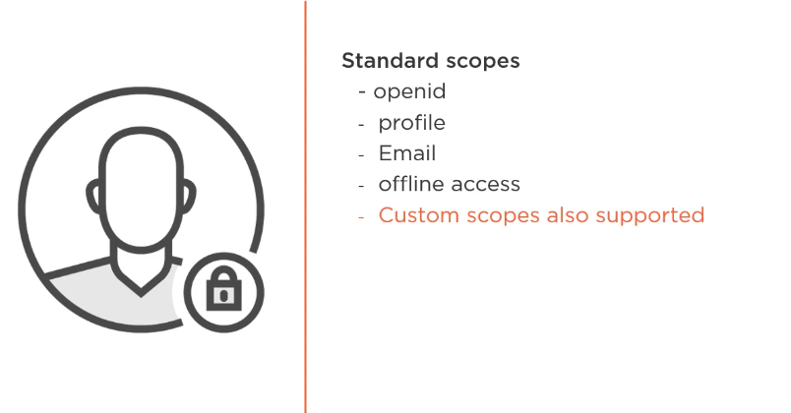
Scopes and Claims

Slide 14
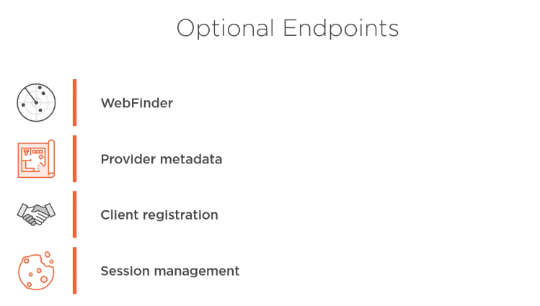
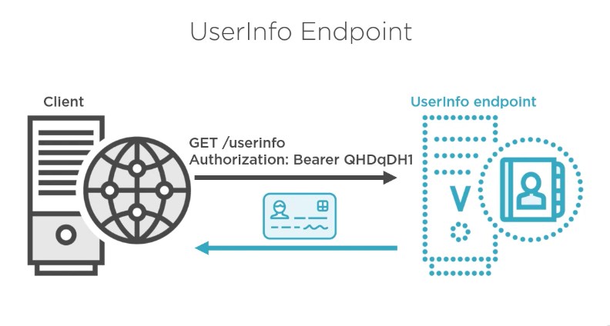
OIDC EndPoints

Slide 15
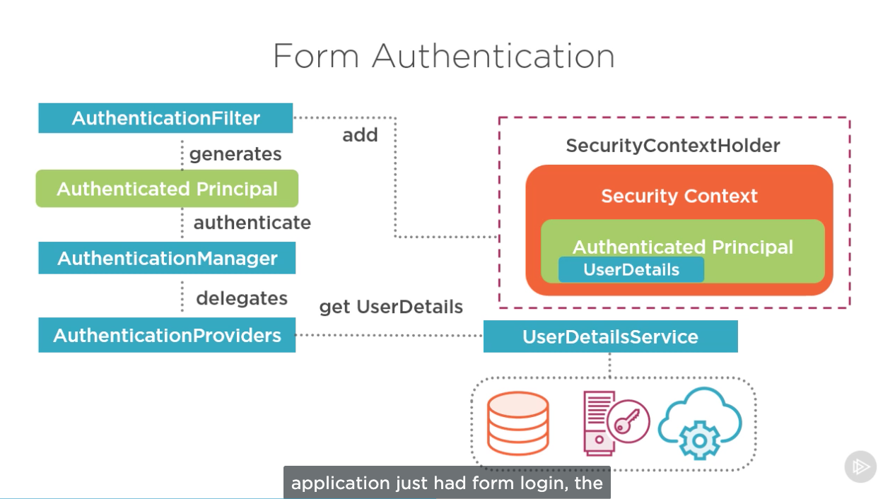
Spring Security FLow

Slide 16
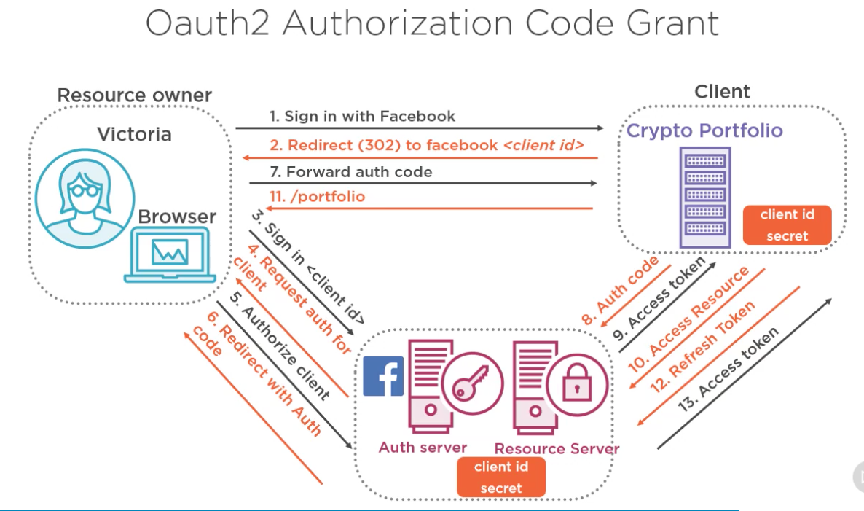
OAUTH2 –Authorization Grant Flow

Slide 17
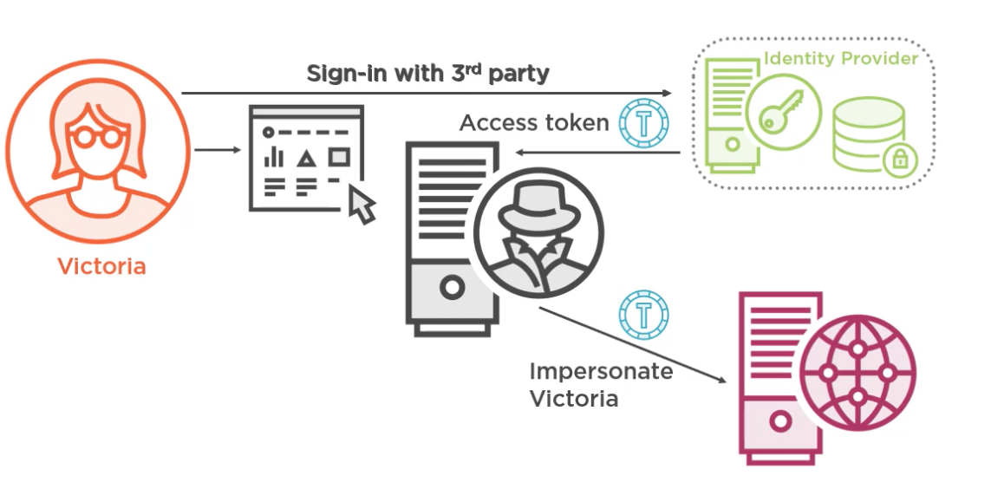
Disadvs of using OAUTH2 for authentication

Slide 18
UserDetailService
+loadUserByUsername(username)
AuthenticationProvider
+authenticate(Authentication)
GenericFilter
UserDetailManager
+loadUserByUsername(username)
+createUser(username)
+deleteser (username)
SecurityContextHolder
OncePerRequestFilter
Principal
SecurityConfigurer
Authentication
WebSecurityConfigurer
AuthenticationManagerBuilder
WebSecurityConfigurerAdapter
+configure(AuthenticationManagerBuilder)
+configure(HttpSecurity)
ProviderManager
EnableWebSecurity
Client
CustomSecurityConfigration
+configure(AuthenticationManagerBuilder)
+configure(HttpSecurity)
AuthenticationManager
+authenticate(Authentication)
HttpSecurity
PasswordEncoder

Slide 19
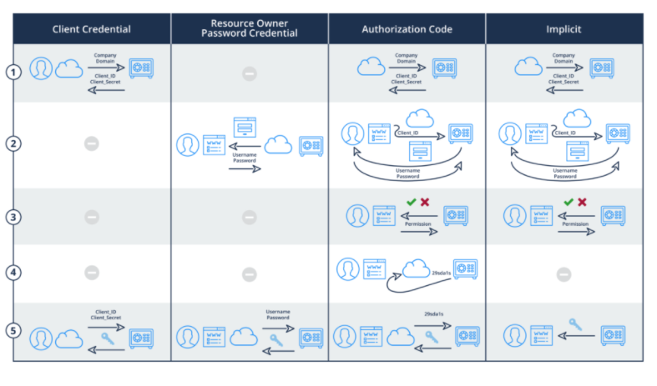
Oauth Grant Flow comparisons

Slide 20
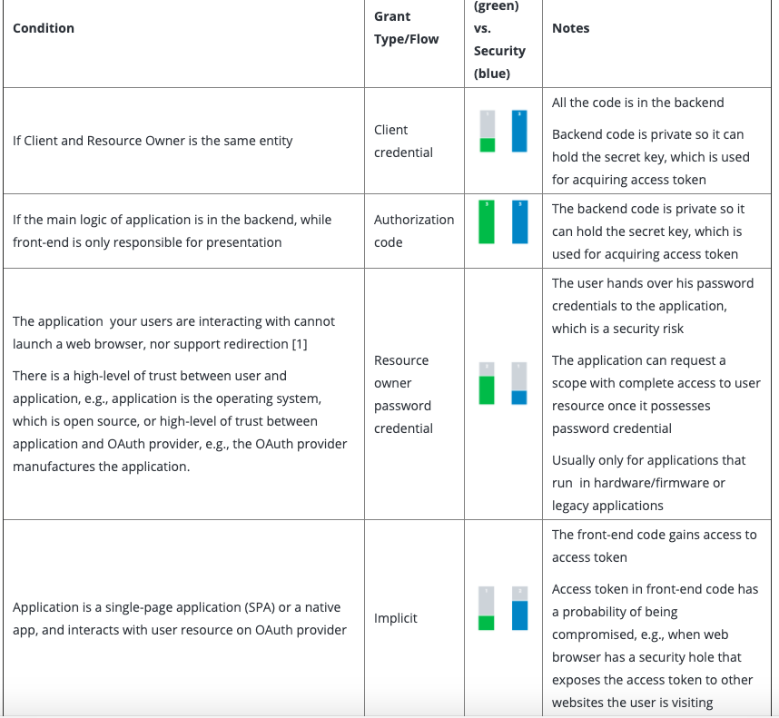
Security vs Difficulty

Slide 21
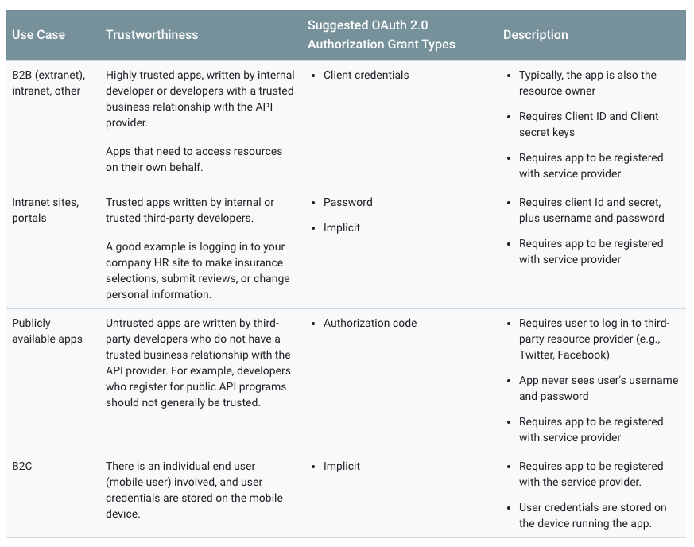
Use cases for OAUTH grant types

